Slide 1
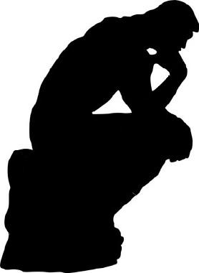
Analytical Thinking
Emphasis on Decision Making
By: Emad Selim

Slide 2


Slide 3


Slide 4
True or False ?
Chemical pollution contributed to the epidemic growth of cancer in the last 10 years
Truth: There is no epidemic and no growth. It is the opposite

Slide 5
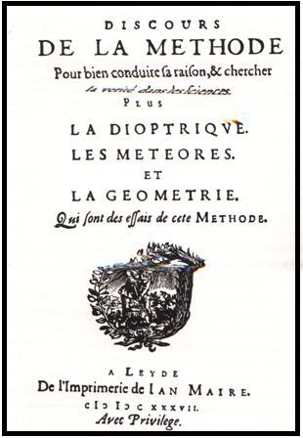
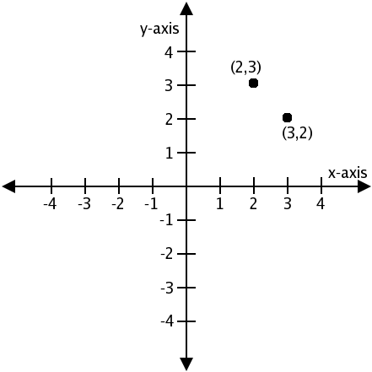
Historical background:
René Descartes (1596 – 1650)
Notes:
Rene Descartes is the inventor of the cartesian coordinates system

Slide 6
Discourse on the Method
Four precepts:
  Accept only that which you are sure of
  Divide into as small parts as necessary
  Solve the simplest problem first
  Make a complete list as possible

Slide 7
Myths about decision making
Decisions are made during meetings:
  Truth: private conversations have a higher impact
Decision making is an intellectual exercise
  Truth: It is much more complicated than that:
    Emotions
    Social pressure
    Politics

Slide 8
Myths about decision making
People analyze situation and then decide:
  Truth:
    Sometimes, analysis is a tool to persuade others/self about what we already decided.
    Decisions rarely flow in a linear way as most tools suggest. We usually uncover more about the problem and more about the solutions as we go.
    Many times we have a solution that we search for a problem for it to solve.

Slide 9
Tips for Better thinking
1) Clarify what you think
State one point at a time
  I think that …..
Elaborate on that point
  In other words, that means that ….
Give Examples
  For example, when ….
Use Analogies
  This is similar to the case of ….

Slide 10
Tips for Better thinking
2) Stick to the point – be specific
What is exactly the problem we are trying to solve?
What are the assumptions we are having ?
What is the reason for these assumptions

Slide 11
Cognitive Biases
Over confidence:
  Psychology suggests that we are usually overconfident in our judgment.
  Credit card borrowing
  Estimating a task ☺
  Confidence is Good, Overconfidence can be tricky

Slide 12
Cognitive Biases
Sunk-cost effect:
  We don’t like to admit that past decision was less than perfect
  Example:
    Casinos make millions because of this bias
    We already spent a lot of money in that, let’s continue
    We already started the project this way
    We already traveled a long way to reach this place
    We already used this

Slide 13
Cognitive Biases
Recency effect:
  We assign higher weight to most recent information
  Example:
    Trial lawyers present their most important witness last
    Things are harder now than before
    But the weather is ok now
    But he is now a better person
    KPIs ☺

Slide 14
Cognitive Biases
Confirmation bias:
  We tend to gather information to confirm our views and play down opposing views
  Example: NASA Columbia Shuttle accident in 2003
    Same managers who designed the foam approved it
    Ask for approval from people they know will agree
  2, 4, 6 experiment, Evans experiment
  We believe news we want to believe and deny news we don’t like
  Peer review vs. personal review: we don’t find our mistakes as easily as we find others’.

Slide 15
Cognitive Biases
Anchoring bias (Focusing Effect):
  Initial references may distort our thinking by positioning a specific item as the most important.
  Example:
    Haggling: Seller starts with 3X price
    Some products focus on price only (their strength)
    Other products focus on quality only (their strength)
    Estimation after Expert judgment for projects

Slide 16
Cognitive Biases
Illusory correlation:
  the phenomenon of seeing the relationship one expects in a set of data even when no such relationship exists.
  Example:
    Stereotypes
    ALL people in Switzerland must be happy
    ALL people from this place are violent

Slide 17
Combating Cognitive Biases
Become aware of them.
Identify if our decision was based on a bias
Try to avoid them in decision making
Note: These are rooted in human nature, they cant be 100% eliminated.

Slide 18
Barriers to analytical thinking
Myths and Prejudices
  Pasteur against myth that micro-organisms auto generate

Slide 19
Barriers to analytical thinking
Conformity
  Can be based on:
    Being too old :
      This is how we do it all the time
    Being too common
      Everyone does that
    Being from a famous person
      Even “HE” does that

Slide 20
Barriers to analytical thinking
Fanaticism
  Unwillingness to listen to the other point of view
  Java fanatics saying: anything from Microsoft is bad
  Anything this person says is wrong

Slide 21
References
Scientific Thinking, Dr. Fouad Zakaria
Tools of Thinking, TTC
Decision Making, TTC

